Slide 1




AppHarbor
AppHarbor Public Cloud
.NET Cloud
.NET Cloud Development Made Easy
George Georgiev
Technical Trainer
http://itGeorge.net
Telerik Software Academy
academy.telerik.com

Slide 2

Table of Contents
What is AppHarbor?
“Control panel” overview
AppHarbor architecture
Deployment process
Runtime
Pricing
Prices
Resources

Slide 3

Table of Contents (2)
Application deployment
Git crash-course
Sample application deployment
Service hooks
Configuration variables and Add-ons
Configuration variables
Mailgun
Shared SQL Server
MongoLab
SVNSailor

Slide 4
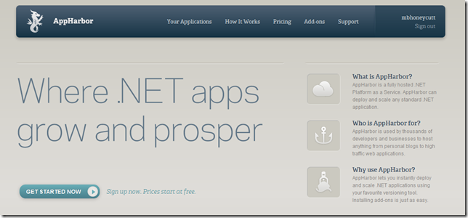
What is AppHarbor?
.NET Platform as a Service

Slide 5

What is AppHarbor?
Fully hosted .NET PaaS
Supports ASP.NET (Web Forms & MVC), WCF, WWF, ADO.NET Entity Framework, etc.
Runs on Amazon EC2
Automatic load balancing
Easy application deployment
Through Git
Through Bitbucket, CodePlex or GitHub
Through SVN (with add-on)

Slide 6

What is AppHarbor? (2)
Automatic build
Code compilation
Unit tests execution
Rich set of add-ons
Provide additional functionality for applications
Shared Microsoft SQL Server, Airbrake, MongoHQ, StillAlive, Mailgun, Blitline, etc.
Forum, support and knowledgebase

Slide 7
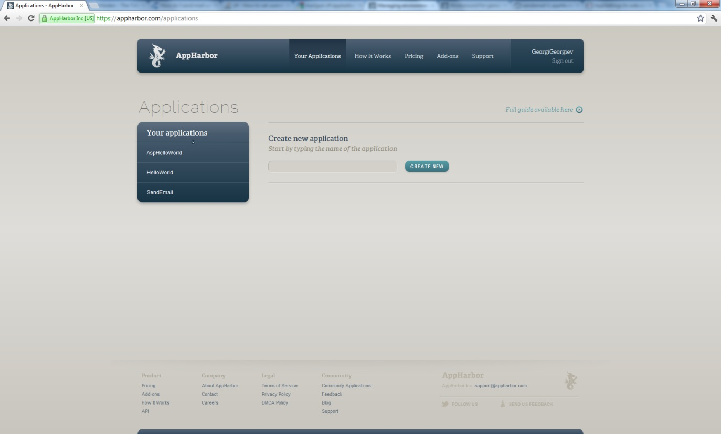
“UI” Overview
A Quick Look over the “Application Dashboard”

Slide 8
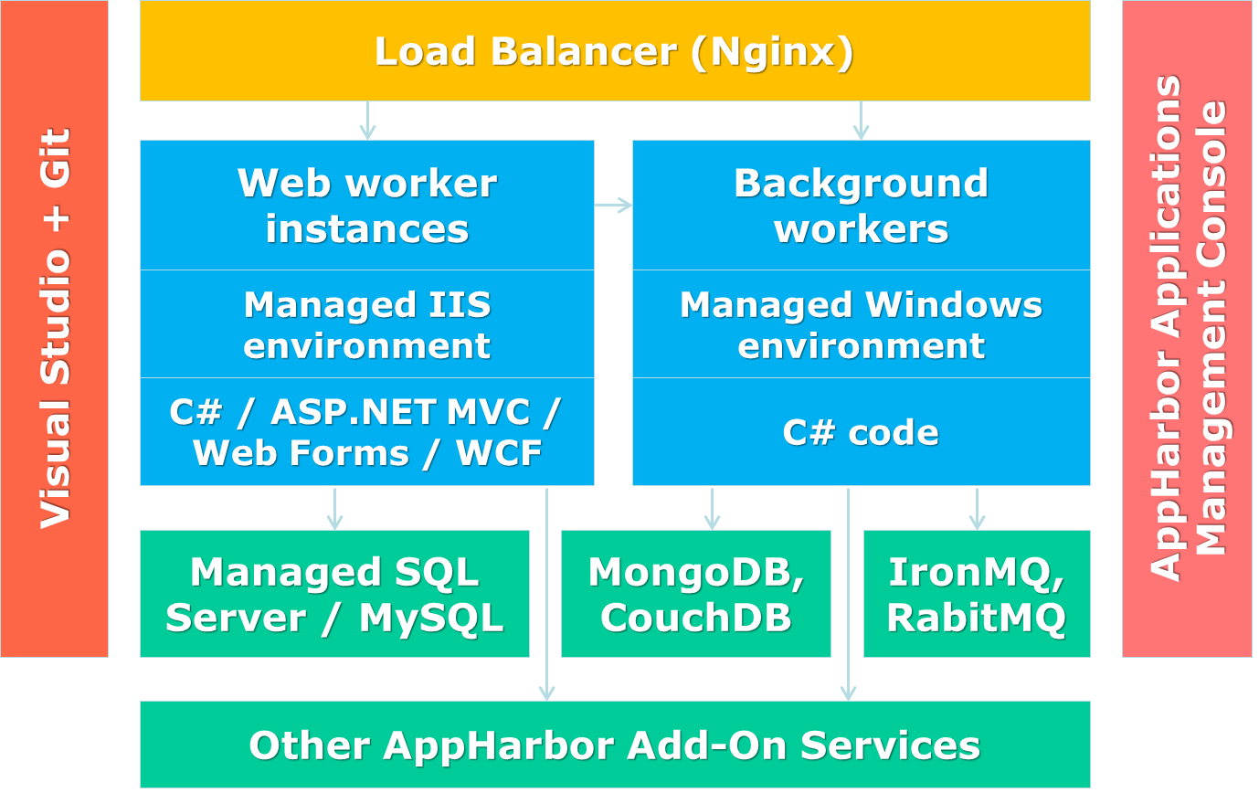
AppHarbor Architecture
Deployment process, Runtime environment

Slide 9
AppHarbor Architecture
Visual Studio + Git
Load Balancer (Nginx)
AppHarbor Applications Management Console
Web worker instances
Background workers
Managed IIS environment
Managed Windows environment
C# / ASP.NET MVC / Web Forms / WCF
C# code
Managed SQL Server / MySQL
MongoDB, CouchDB
IronMQ, RabitMQ
Other AppHarbor Add-On Services

Slide 10
AppHarbor Architecture (2)
Deployment process
User pushes (sends) .NET code
Code is built by a platform build server
If code compiles, unit tests are run
Results appear on the application dashboard
Service hooks are called
Application deployed to the AppHarbor application servers.
AppHarbor scales application when needed

Slide 11
AppHarbor Architecture (3)
Application runtime environment
Load balancing is automatic
SSL connections, HTML compression, etc. are handled
Everything runs on AWS and is managed by AppHarbor
Cloud resources are consumed through add-ons
More info: https://appharbor.com/page/how-it-works

Slide 12

Pricing
Plans and Resources

Slide 13
Pricing and Resources
AppHarbor worker
Process which can have multiple threads
Limited in resources
2 workers always on different machines
Resource limit per worker
Network Bandwidth: 100GB/month – Soft
RAM usage: 512MB - Soft; 1024MB – Hard
CPU resources: ~600MHz – Hard
Requests Queue limit: 500 Requests
Request timeout: 30 seconds - Soft; 120 seconds - Hard

Slide 14

Pricing and Resources (2)
AppHarbor background worker
Regular .NET console application
.exe’s produced on compilation
Used for
Recurring tasks
Schedules
Etc.

Slide 15

Plans (Canoe)
Canoe plan
0$ per month
1 worker
apphb.com hostname
Piggyback SSL

Slide 16

Plans (Catamaran)
Catamaran plan
49$ per month
2 workers
Custom hostnames
SNI SSL

Slide 17

Plans (Yacht)
Yacht plan
199$ per month
4 workers
Custom hostnames
IP-based SSL

Slide 18
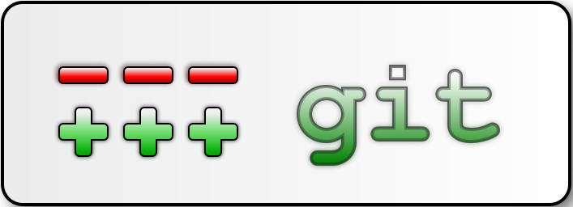
Git Crash Course
Only What You Need to Know to Use AppHarbor

Slide 19
Git Crash Course
Git
Source-control system
Can work with local and remote repositories
Git Bash – command line interface for Git
Free
Has Windows version (msysgit)
http://code.google.com/p/msysgit/downloads/detail?name=Git-1.7.10-preview20120409.exe&can=3&q=

Slide 20
Git Crash Course (2)
Installation –
“next, next, next” does the trick
Options to select (they should be selected by default)
“Use Git Bash only”
“Checkout Windows-style, commit Unix-style endings”
Note: this concerns only beginners

Slide 21
Git Crash Course (3)
Using Git Bash
Standard command prompt with added features
Creating a local repository
git init
Preparing (adding/choosing) files for a commit
git add [filename] (“git add .” adds everything)
Committing to a local repository
git commit –m “your message here”

Slide 22
Git Crash Course (4)
Using Git Bash (2)
Git “remote”– name for a repository URL
Git “master” – the current local branch (think of it as “where you have committed”)
Creating a remote
git add remote [remote name] [remote url]
Pushing to a remote (sending to a remote repository)
git push [remote name] master

Slide 23

Using Git Bash
Live Demo

Slide 24
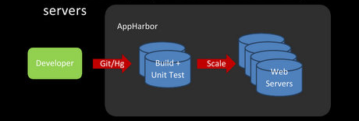
Application Deployment
Deploying your Application to AppHarbor

Slide 25
Application Deployment
Getting your code to AppHarbor
Through Git
AppHarbor provides Repository URL
Use Git to push to that URL
Other source-control systems – commit to some integrated with AppHarbor repository
Through Bitbucket, Codeplex, GitHub
Have integration with AppHarbor
Can push code to AppHarbor’s repository

Slide 26
Git and AppHarbor
AppHarbor “requirements”
Submit a .NET Solution with
All project files
All code files, libraries, etc.
All other resources
Solution must be a web application
If there is more than ONE solution file
AppHarbor compiles the one named “AppHarbor.sln”

Slide 27
Git and AppHarbor
First deployment to AppHarbor with Git
Initialize a repository where your solution is
Add the relevant files to be committed
Commit to local repository
Create a remote to AppHarbor repository (get the URL from your application’s “dashboard”)
Push to the remote you created for AppHarbor
…and that’s everything!

Slide 28
Git and AppHarbor
Next deployments to AppHarbor
Add the relevant files to be committed
Either all the files from before or only the ones you modified
Commit to local repository
Repository was created in the “First deployment”
Push to the remote for AppHarbor
We created this the first time too
Your application dashboard now has a history!

Slide 29

Deploying to AppHarbor
Live Demo

Slide 30
AppHarbor Service Hooks
URLs to which AppHarbor POSTs build info
After a build is deployed (or failed deploying)
Can be your own service or, e.g. TweetHarbor
Format of the POST body:
{ "application": { "name": "Foo", "slug": "foo", "url": "https://appharbor.com/applications/foo" }, "build": { "id": "bar", "branch" : { "name" : "baz", "commit" : {
"id" : "77d991fe61187d205f329ddf9387d118a09fadcd", "message" : "Implement foobar" } }, "status": "succeeded", "url": "https://appharbor.com/applications/foo/builds/bar" } }

Slide 31
Configuration Variables and Add-ons
Customizing and Enriching Your Application

Slide 32
Configuration variables
Key-value pairs
Correspond to <appSettings> in Web.config
Overwritten on deployment in AppHarbor
Used to change the behavior of your application on AppHarbor
e.g. variable telling your app it's on AppHarbor
Added by user
Added by add-ons
Connection strings, logins, other add-on data

Slide 33
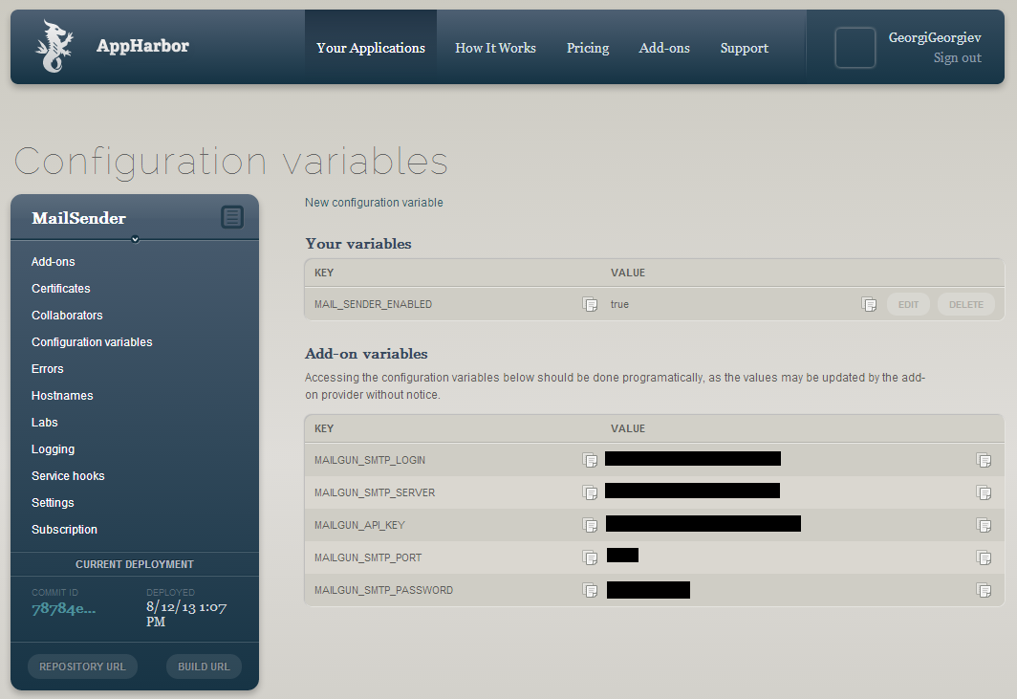
Configuration variables
Adding a configuration variable in AppHarbor
Go to Application dashboard >> Configuration variables >> New configuration variable

Slide 34
Configuration variables
Adding and editing configuration variables
In your application config file (e.g. Web.config)
Accessing configuration variables through C#
Stored in the ConfigurationManager class
AppSettings property (dictionary)
<appSettings>
<add key = “my key” value = “my string value”/>
...
</appSettings>
using System.Configuration;
…
string myValue =
ConfigurationManager.AppSettings["my key"];

Slide 35

Configuration Variables
Live Demo

Slide 36
Add-ons
Add-ons allow you to consume cloud resources
Added from add-on catalogue
Each application has its independent add-ons
Each add-on has a “control page”
Various settings, controls, etc.
From Application Dashboard click the add-on, then “Go to [add-on name]”
Use configuration variables for interaction with your application
Most have free versions

Slide 37
Mailgun
Mailgun add-on provides e-mail services
Analysis and statistics tools
SMTP, POP3, IMAP
Has a C# API
Gives you hostname, login, password
Through configuration variables
Free – 300 messages/day, temp storage
19$/month – 50000 messages/month, 20GB
Configuration variables:
MAILGUN_SMTP_LOGIN, MAILGUN_SMTP_SERVER, MAILGUN_API_KEY, MAILGUN_SMTP_PORT, MAILGUN_SMTP_PASSWORD

Slide 38
Mailgun
Using Mailgun with C#
NuGet package "mnailgun" (not a type-o):
Can use SmtpClient for lower-level access
using Typesafe.Mailgun
…
var domain = "app14337.mailgun.org"; //No exact config varaible
var key = ConfigurationManager.AppSettings["MAILGUN_API_KEY"];
var from = "mail@example.com"; //note: can send from any address
//note 2: don't!
var to = "me@example.com";
var mail = new System.Net.Mail.MailMessage(from, to)
{
Subject = "Example mail",
Body = "The quick brown fox jumps over the lazy dog"
};
var mailClient = new MailgunClient(domain, key);
mailClient.SendMail(mail);

Slide 39

Mailgun Add-On
Live Demo
http://mailsender-1.apphb.com/

Slide 40
MongoLab
Managed MongoDb in the cloud
Hosted on Amazon EC2
REST API
Works fine with 10gen C# driver
Good administration tools
Free: 0.5 GB instance
Paid plan: 1 – 20 GB instance, $10 – $65 / month
+ automatic backups, + monitoring
Configuration variables:
MONGOLAB_URI

Slide 41
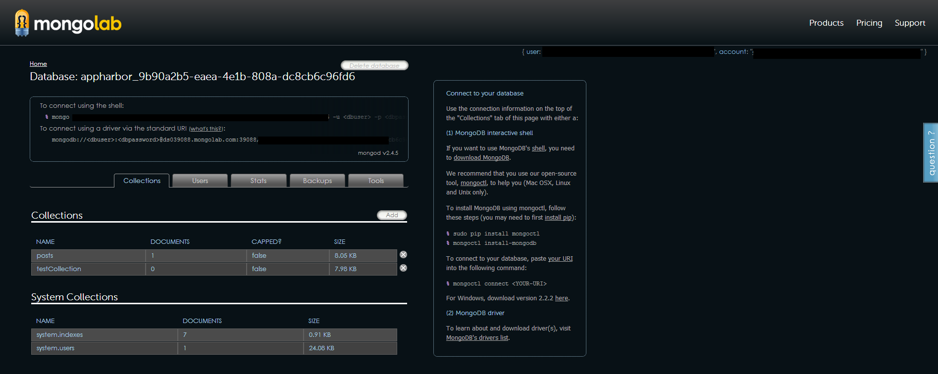
MongoLab
"Go To MongoLab"
Redirects to MongoLab
Full-featured administration (CRUD, settings, stats, tools)

Slide 42
MongoLab
Using MongoLab with C#
With NuGet 10gen driver package
using MongoDB.Driver;
using MongoDB.Driver.Linq;
…
var mongoUrl = ConfigurationManager.AppSettings["MONGOLAB_URI"];
MongoClient client = new MongoClient(mongoUrl);
var server = client.GetServer();
var db = server.GetDatabase(mongoDatabase);
var posts = db.GetCollection("posts");
posts.Insert(...);
var query = from p in posts.AsQueryable<PostModel>()
select p;
foreach(PostModel post in query) {...}

Slide 43

MongoLab Add-On
Live Demo
http://posted.apphb.com

Slide 44
Shared SQL Server
Shared SQL Server
Provides a SQL Database
Gives you a server URI, username and password
Gives you a connection string
Configuration variable with alias
Free – 20 MB
Shared DB processing: 200ms/s CPU time – Soft
10$/month – 10 GB
Configuration variables
SQLSERVER_CONNECTION_STRING, SQLSERVER_CONNECTION_STRING_ALIAS, SQLSERVER_URI

Slide 45
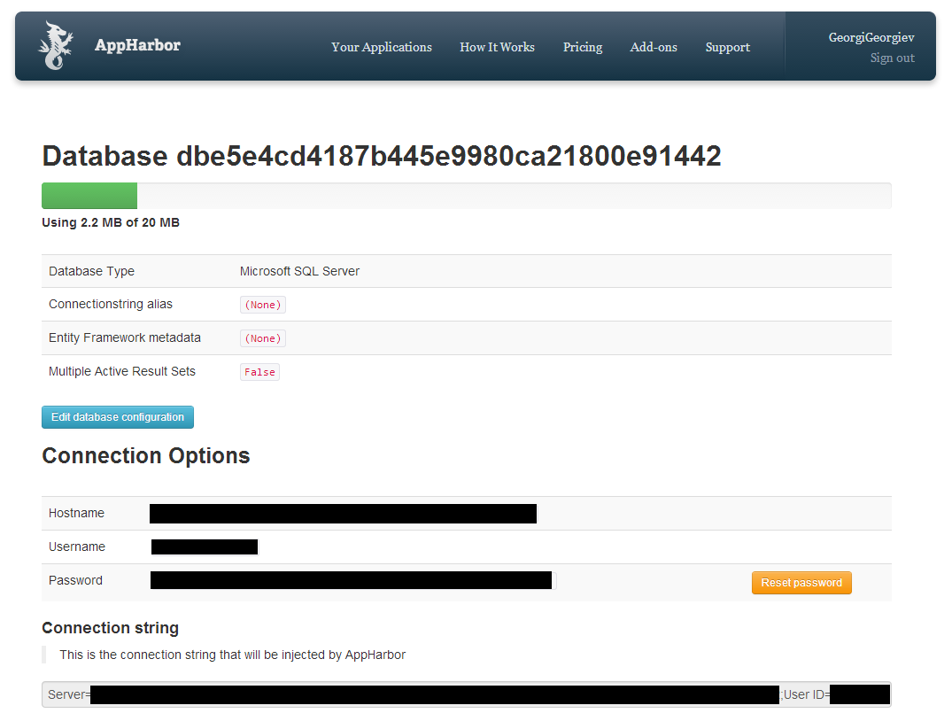
Shared SQL Server
"Go To SQLServer"
Connectionstring
Database name
Alias editing
Hostname
Username
Password

Slide 46
Shared SQL Server
Using SQLServer with C#
Same as you would a regular SQL database
Create an entity model through Visual Studio
Use Hostname, Username and Password from the add-on's page

Slide 47
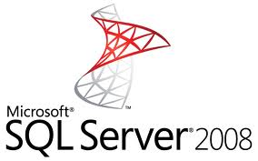
SQL Server Add-On
Live Demo

Slide 48
SVNSailor
SVNSailor enables SVN commit support
Connects to a SVN repository (e.g. in Google Code) by given:
Url, Username, Password
On commit to the SVN repository:
Builds the code
Deploys it on AppHarbor
Free – first 5 commits
Paid – 5$/month – unlimitted commits

Slide 49
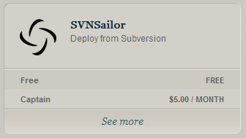
SVN Sailor Add-On
Live Demo

Slide 50


Other Add-Ons
Airbrake (error logging)
Blitz (performance monitoring)
CloudAMQP (RabbitMQ)
Cloudant (CouchDB)
CloudMailin (incoming email)
Dedicated SQL Server
JustOneDB (NoSLQ database)
Logentries (log management)

Slide 51


AppHarbor: Add-Ons (2)
Memcacher (in-memory caching)
MongoHQ (managed MongoDB)
MySQL (shared MySQL DB)
RavenHQ (NoSQL database)
Redis To Go (key-value store)
SendGrid (email delivery)
StillAlive (app monitoring)

Slide 52
AppHarbor
?
?
?
?
?
Questions?
?
?
?
?
?
?

Slide 53
Exercises
Write a "code jewels*" service. The service should enable POSTing a code jewel, GETing all code jewels and searching for code jewels by source code and by category (and retrieving them). The service should also enable voting for and against a code jewel (+ and -). Code jewels with very low scores should be deleted from the database. A code jewel has a category (e.g. "C#", "JavaScript", ...), an author's mail (e.g. me@itgeorge.net), a rating and source code. Deploy the service to AppHarbor. Implement deactivating the POSTing of code jewels through the AppHarbor interface. *A code jewel is any relatively short, but useful piece of code (e.g. checking a bit's value, recursively deleting files, etc.)

Slide 54
Exercises
Develop a service hook, which maintains a list of e-mails, to which it sends an e-mail with the hooked app's name as a subject and the commit message as a body. The list of e-mails should be stored in a database, to which only the administrator has access. Upload the service to AppHarbor and hook the Code Jewels application to it.

